Slide 1
Grand Lodge of Virginia
Masonic Youth Presentation

Slide 2
Confident young women, Respecting tradition, Shaping the future
www.jdiva.org

Slide 3
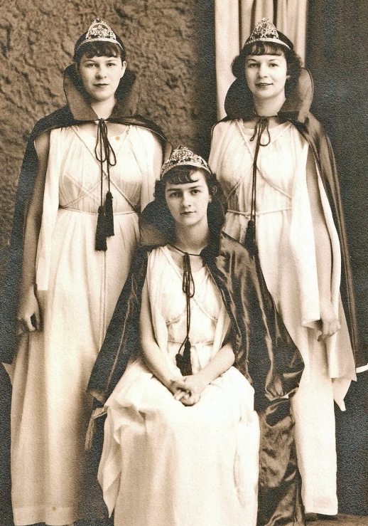
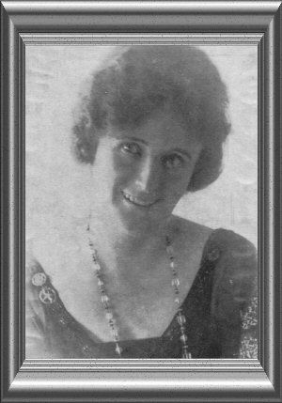
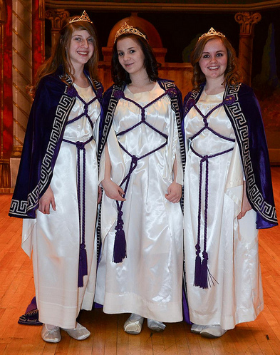
History
Founded in 1920 in Omaha, Nebraska by Mrs. Ethel T. Wead Mick, based on Job 42:15
Purpose: To give young women an opportunity to work together to learn leadership skills, respect for parents and family, and love of one’s country
Membership in 5 countries (US, Canada, Australia, Philippines, Brazil)
Officers wear Grecian robes, symbols of democracy and equality
Virginia has 15 Bethels and 150 members
“And in all the land were no women found so fair as the Daughters of Job; and their Father gave them inheritance among their brethren.” – Job 42:15
Notes:
Job’s Daughters International is managed at the Supreme, Grand and Bethel levels by Supreme Guardian Council, Grand Guardian Council and Bethel Guardian Council. Local Bethels are a self-governing group. Each Bethel elects an Honored Queen and the Officers to lead them for a six-month term. The Honored Queen and Officers help run the Bethel and take care of business such as finances, planning events, fundraising, social and fun activities, all with the guidance of adult volunteers. They are assisted by the Bethel Guardian Council of both men and women who serve in elected and appointed positions. The Grand Guardian Council is the adult leadership that serve at the State level along with the elected Grand Guardian Council progressive line adults. Miss Job’s Daughter and the Grand Bethel Honored Queen are State representatives. Job’s Daughters International headquarters is in Papillion, Nebraska. The Supreme Bethel Honored Queen and Miss International Job’s Daughter are international representatives and serve along with the elected Supreme Guardian Council progressive line adults. Scholarships are available at the Grand and Supreme levels. In 2021, ten $1,000 scholarships were awarded!

Slide 4
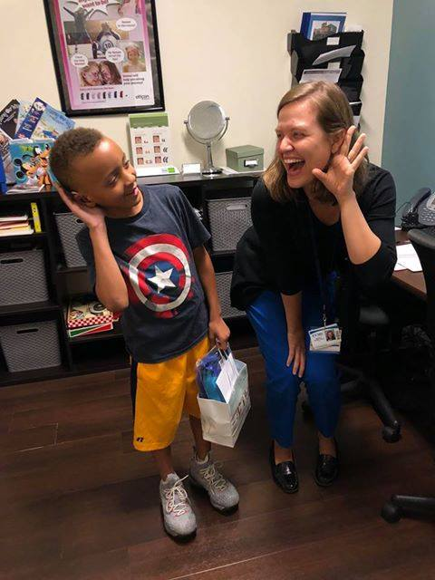
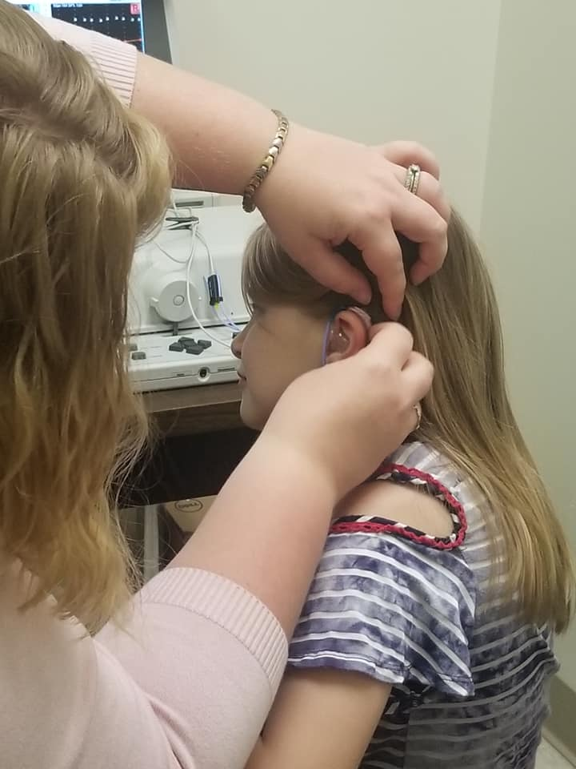
Mission and Philanthropy
“To be fair is to do good” is the primary teaching of Job’s Daughters
Bethel life is about sisterhood, leadership and service
Official philanthropy is The HIKE Fund, Inc., founded in 1985
Provide hearing devices for children with hearing loss between the ages of newborn and 20 years (about 75 children are provided with hearing devices each year)
Virginia has raised over $530,000 since 1985 for The HIKE Fund, Inc., including $34,025 in 2018-2019
www.thehikefund.org
Notes:
To be a member of Job’s Daughters is to be part of a group that promotes friendship among young women and confidence in themselves. Members learn skills that will aid them throughout life. Job’s Daughters is an organization that serves the community.
Job’s Daughters Bethels perform community service activities independently within the communities they reside and work in conjunction with all the other bodies in the Masonic family in performing fundraising and direct support for charities.
The official Philanthropy for the Order in the Hearing Improvement Kids Endowment other wise known as HIKE and raises fund yearly to support the mission of providing hearing aids to children in need. HIKE also supports purchasing items needed for the hearing impaired to support development and educational activities and endeavors to work in conjunction with audiologists and speech pathology programs to directly support those with the greatest needs.

Slide 5
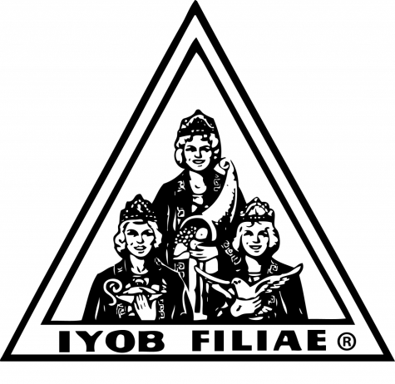
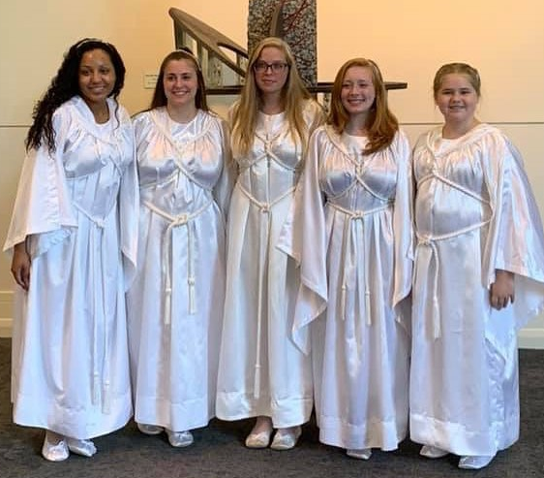
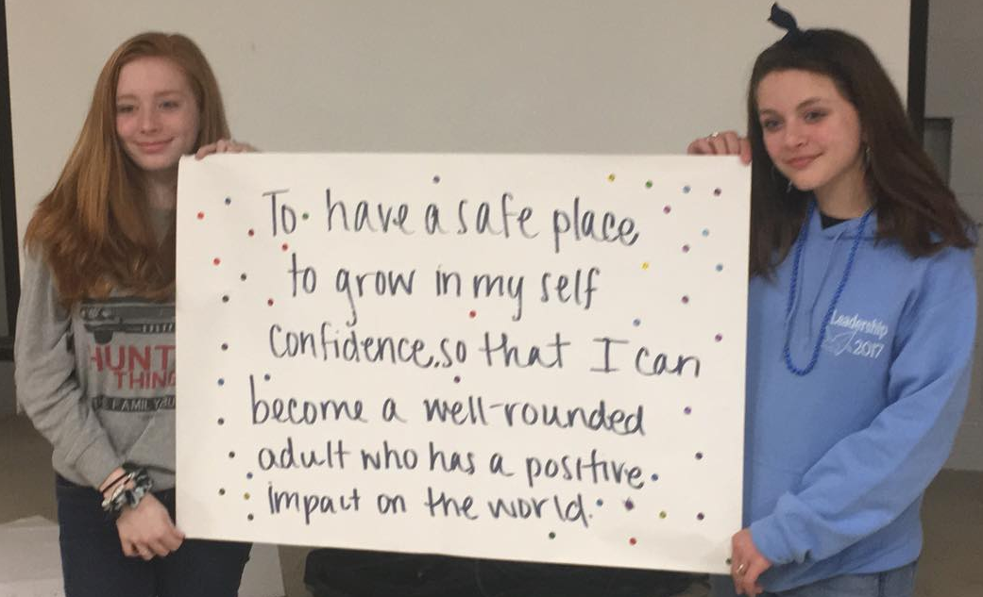
Mission and Philanthropy
The emblems of Job’s Daughters are the white dove, the urn of incense and the horn of plenty, symbolizing truth, prayer, and reward for faith in God.
The lily of the valley is the emblematic flower and represents beauty, purity, and humility.

Slide 6
Organization and Structure
Supreme Level Leadership
Supreme Bethel Honored Queen
Supreme Guardian and Associate Supreme Guardian
Grand/Jurisdictional Level Leadership
Grand Bethel Honored Queen
Bethel Level Leadership
Honored Queen
Miss International Job’s Daughter
Executive Manager and the Board of Trustees
Miss Job’s Daughter
Grand/Jurisdictional Guardian and Associate Grand/Jurisdictional Guardian
Bethel Guardian and Association Bethel Guardian
Deputy Grand Guardian
Junior Miss Job’s Daughter
Notes:
Jobs Daughters Organization is managed at the international level by the Supreme Guardian Council, at the State or regional level by Grand Guardian Councils or Jurisdictional Councils and locally by the individual Bethels that fall under oversite by one of the higher bodies.
The Supreme Council is supported by the Organizational Headquarters main office in Papillion, Nebraska and contains an elected adult leadership (Supreme) Line, the Supreme Bethel Honored Queen and the Miss International Jobs Daughter and the heads of the body.
Grand Guardian Councils are the State level management body and function through an elected adult Grand leadership line, Grand Bethel Honored Queen and a State Miss Jobs Daughter.
Jurisdictional Councils are led by appointed adults to manage the Bethels within the State or Jurisdiction that do not meet the requirements to have a full Grand status. These Councils operate with reduced authority and rely on Supreme Council for additional support.
Local Bethels are a self-governing group. Each Bethel elects an Honored Queen and the Officers to lead them for a six-month term. The Queen and Officers help to run the group and take care of business such as keeping track of finances, planning fund raising events, social and fun activities, all with the guidance of adult volunteers. They are assisted in operations by a Council of Adults, both men and women who serve via elected and appointed positions.

Slide 7
Organization and Structure
Jobie to Bee
Ages 7-9
Focus is on sisterhood and fun
Job’s Daughter
Ages 10-19
Applies to join, is visited by members and then initiated
Majority Member
Ages 20+
Focus is on giving back as an adult volunteer
Focus is on leadership, service and sisterhood
Notes:
Jobie to Bees are introduced to Job’s Daughters, attend many activities and join at the beginning of the meetings and at closing. Job’s Daughters members learn leadership skills, organizational methods, and the importance of fulfilling individual responsibilities within a group. Job’s Daughters provides opportunities for young women to develop confidence, good character, life-long friendships, moral and spiritual values while helping others and having fun.
Majority Members share their experiences, give encouragement, assistance and become member of Bethel Guardian Council.

Slide 8
How to Start a Bethel
Prospective Member Club
Any number of girls ages 10-19
3–4 adult volunteers
Instituted Bethel
Minimum of 10 girls for a new Bethel (only 8 girls if re-instituting a closed Bethel)
9 adult volunteers
Chartered Bethel
Must have minimum of 10 girls and 9 adult volunteers
Sponsoring body and meeting location secured
Apply for institution ($75)
Obtain Bethel paraphernalia and necessary supplies
12 months to receive charter
Apply for charter ($25)
All books in order
Members are proficient in ritual work
Held two meetings per month and monthly Council meetings
Establish meeting schedule
Notes:
Prospective Member Clubs: The initial step in creating a Bethel requires 3-4 adults and any number of Girls ages 10-19. This allows the adults to establish and educate themselves on the history, activities and operational needs of a Bethel.
Identify a sponsor and/or meeting place. While Job’s Daughters does not require a formal sponsoring body to open a Bethel, it’s invaluable to have a Masonic lodge or Eastern Star chapter invested in the success of starting (or restarting) a Bethel.
Generate Interest - Create a network that can begin identifying potential members, their parents, and adult volunteers
Make sure the members of your Lodge and neighboring lodges know what Job’s Daughters is and that the opportunity to start a Bethel is under discussion.
Spread the word to Masonic family organizations in your community.
Reach out to individuals in our area who have worked previously with Job’s Daughters
Generate Enthusiasm
Hold informational events to provide more information about the order for prospective parents, daughters, and adult volunteers.
Plan events for prospective members to show them what the Job’s Daughters experience is like. These can include fun events, community service events, and even participation in Virginia Job’s Daughters activities that are open to non-members
Instituting a Bethel:
Once sufficient numbers of adults and daughters have been established through the Prospective Member Club, a request can be submitted to establish a new Bethel as Under Dispensation body, or Bethel UD
To reinstitute a Bethel (restart a Bethel where one previously existed), a minimum of 8 Job’s Daughters and/or applicants for membership and 5 Executive Council Members must be identified
To charter a new Bethel, a minimum of 9 Job’s Daughters and/or applicants for membership and 9 council members are needed.
A Bethel Under Dispensation functions similarly to other Bethels, but allows the new Bethel time to grow in number, learn more about the workings of a Bethel and Bethel Guardian Council, and ensure that the Bethel will remain sustainable following chartering
Chartering a Bethel:
Requires a minimum of 10 members and 9 adults serving as council members (5 Executive members and 4 Associate members).
In addition to the membership requirements, the Bethel Under Dispensation must meet additional criteria prior to being chartered, such as
holding regular semi-monthly Bethel meetings in full regalia and in accordance with the Job’s Daughter Ritual, Constitution, Bylaws, and Standard Operating Procedures
Officers are proficient in the ritual work of their stations
Term plans include Initiation, Service Projects, Fundraisers, Religious Observance and Fun Activities in accordance with the Constitution and Bylaws
Bethel Guardian Council meetings are being held monthly
Guardian Secretary and Guardian Treasurer’s books and other records are being maintained appropriately
The time between Instituting/Reinstituting and chartering should be no more than 12 months
Grand Secretary of Virginia
Email GS@JDIVA.org
Phone (804) 307-8232

Slide 9
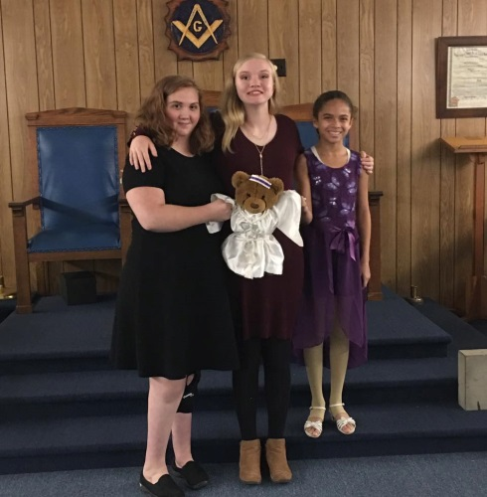
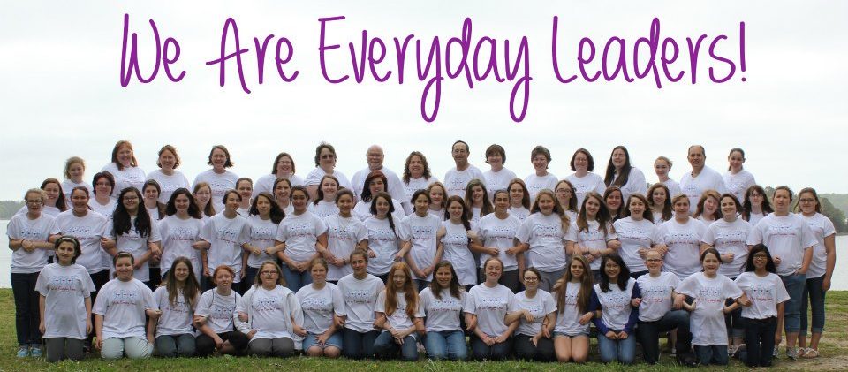
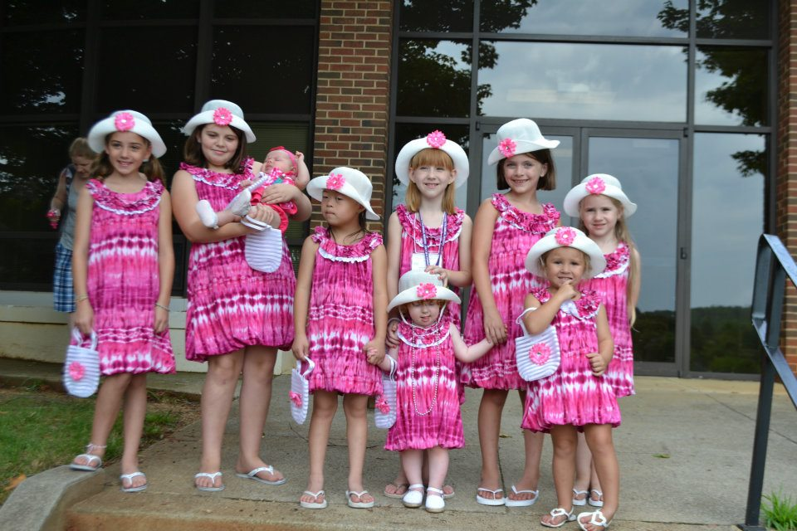
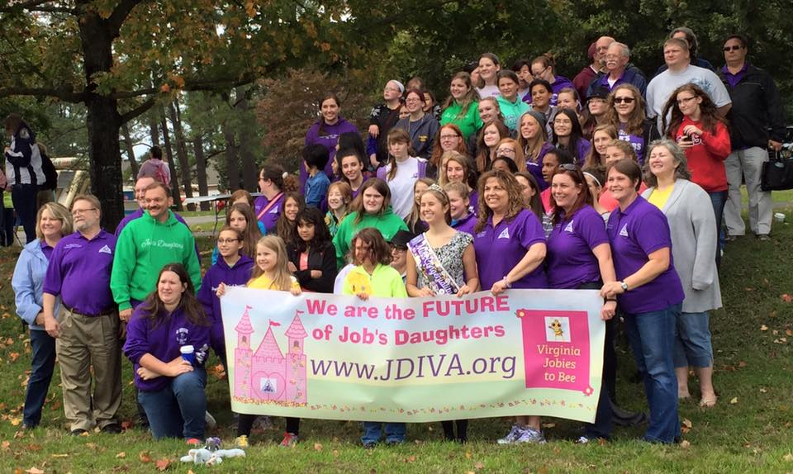
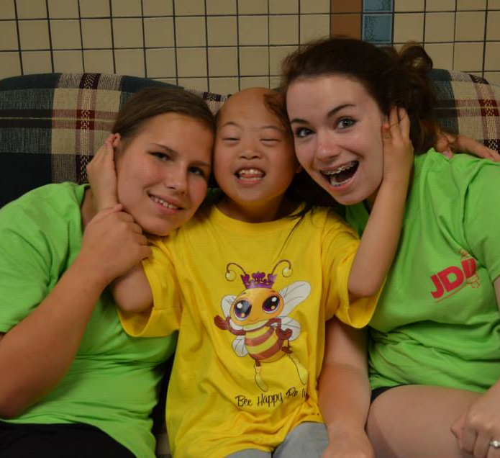
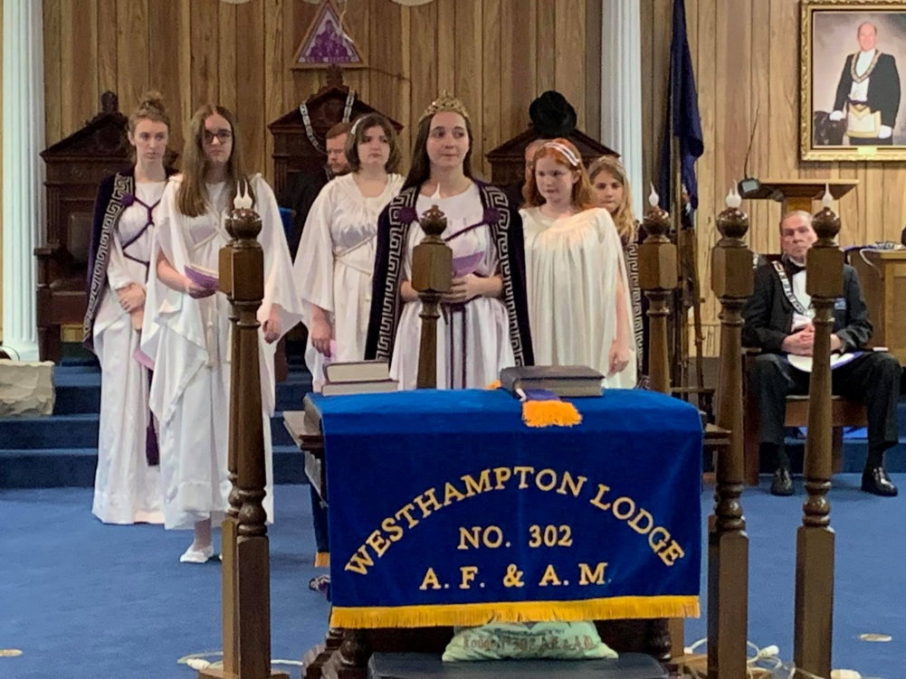
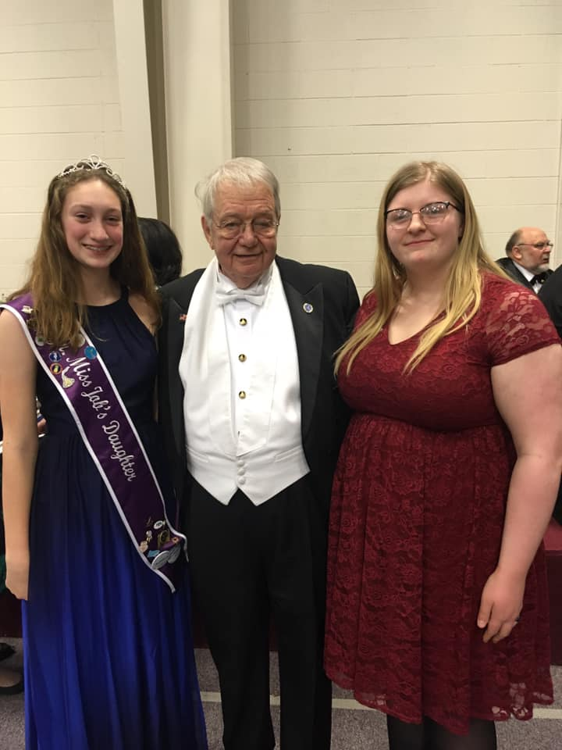
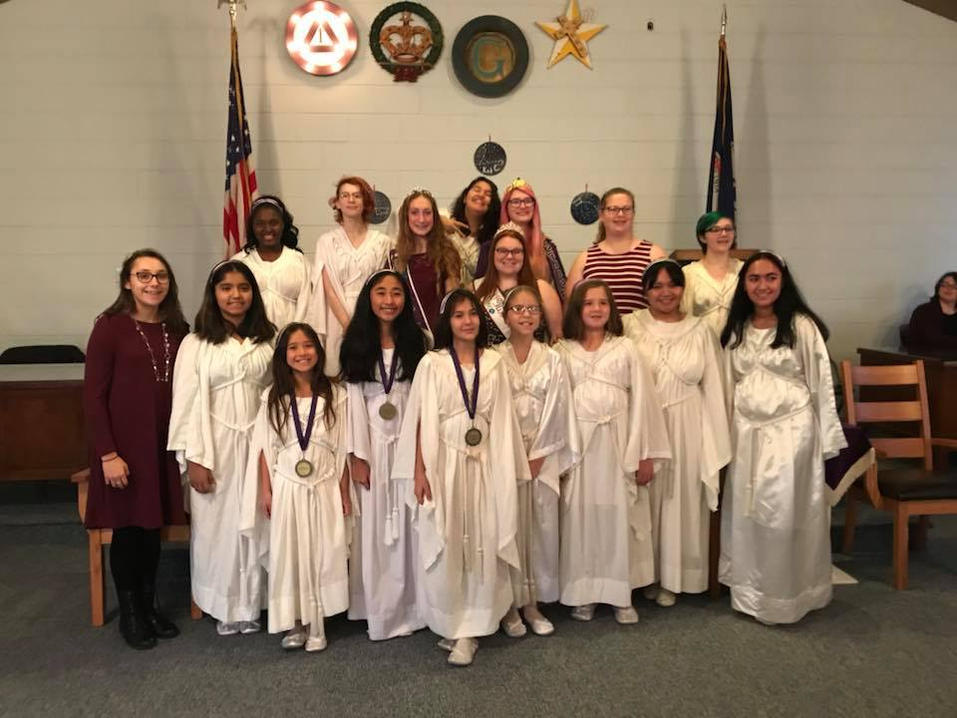
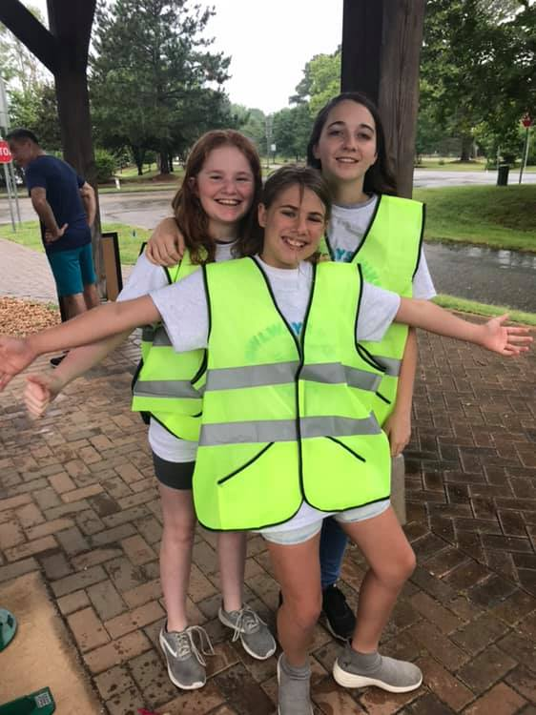
Confident young women, Respecting tradition, Shaping the future

Slide 10
Contact Information
Grand Secretary of Virginia Job’s Daughters
Email : GS@JDIVA.org
Phone : (804) 307-8232

